Slide 1

Cyber Defense Organization
Spring 19’ - Intro to Linux

Slide 2
Sign in?
Spring 19’ - Intro to Linux

Slide 3

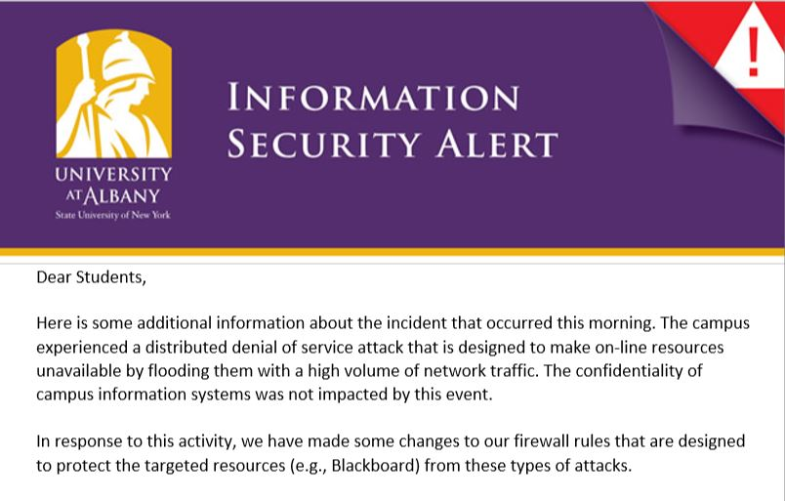
Hacking on our Campus?!

Slide 4
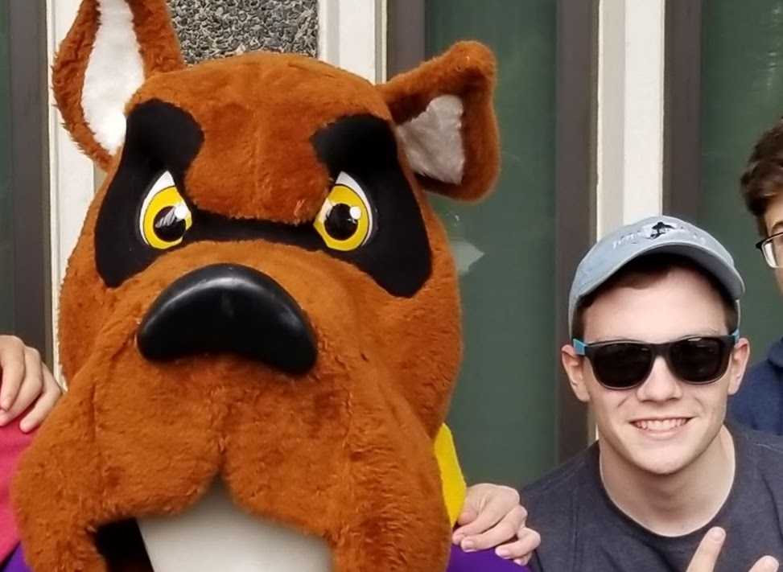
Anthony Capece
Junior
From upstate NY
Linux Coach
Competition i've been to…
A lot

Slide 5

Max Kirby
Freshman
From Long Island
Linux Specialty
Competitions that I’ve been too…
Cny Hackathon
UBNet Def
CCDC Qualifiers

Slide 6
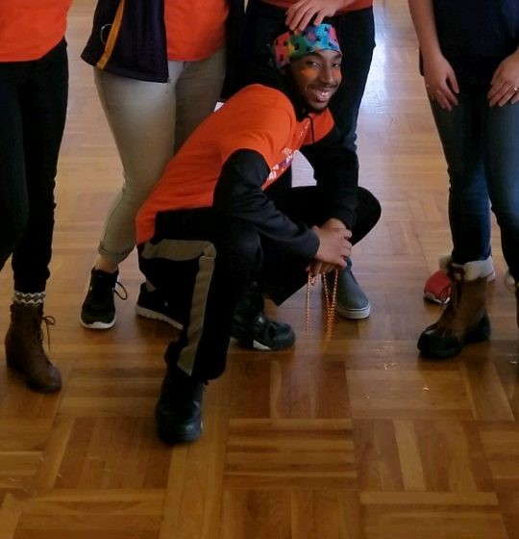
Daunte Kinsey
Freshman, Digital Forensics Major
Linux Specialty
Competitions that I’ve been too…
Cny Hackathon
UBNet Def
CCDC Qualifiers

Slide 7

Small “Term” of the Week:
Blue Team - The team in a cyber security competition that is given a network to defend. (You!)
Red Team - The team in a cyber security competition that is tasked with attacking the blue team’s networks. (Boo!)
White Team - The people that will help you along the way during the competition. They do not compete.
Black Team - Helped create the infrastructure for the competition and are tasked with making sure everything is running correctly.

Slide 8

Introduction to Linux
Introduce you to the fundamentals of Linux
Familiarize you with history of Linux
Groundwork for future workshops/competitions

Slide 9
What is Linux?
Linux is an NOT an operating system. It’s a kernel! Operating systems are based of linux.
There are many different operating systems based of original Linux:
Ubuntu
Kali (Used in tv show “Mr Robot”)
CentOS
Fedora

Slide 10
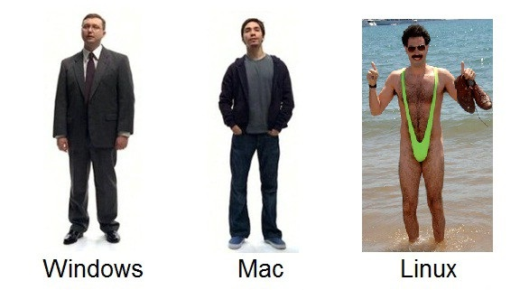
What makes Linux Awesome?
It’s free.
Command-line format. (Which makes you feel like a real hacker)
More secure.
Stripped down.
Direct modification of Configuration Files.
Can run all services.

Slide 11
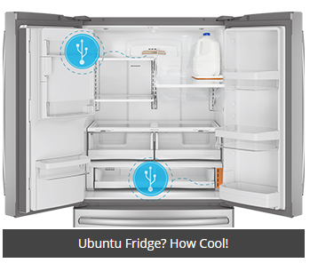
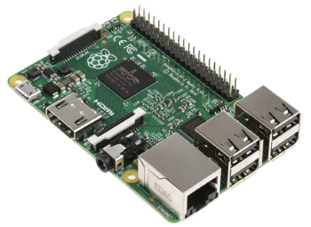
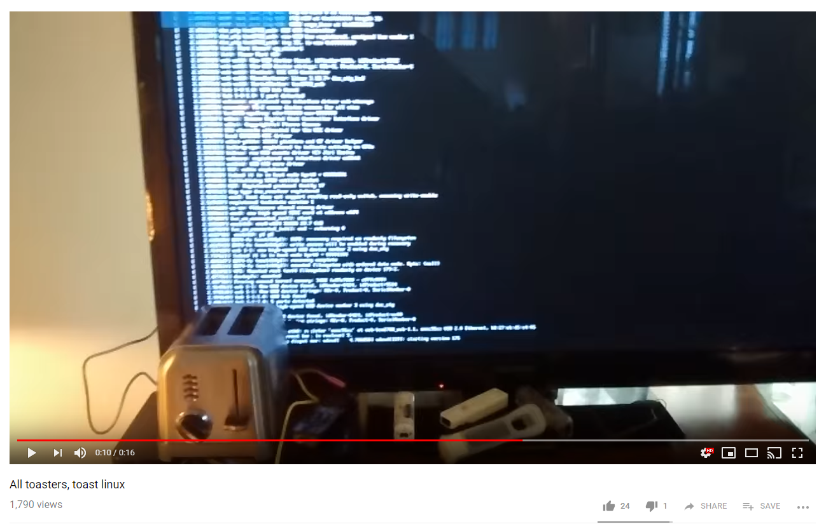

What makes Linux Awesome pt. 2?
Linux can become a portable operating system and is used in many devices.
POSIX (Portable Software)

Slide 12
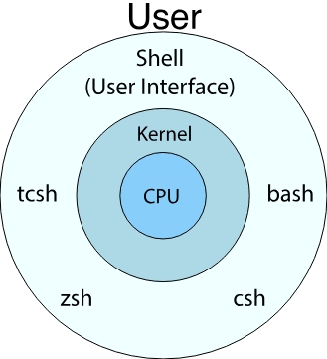
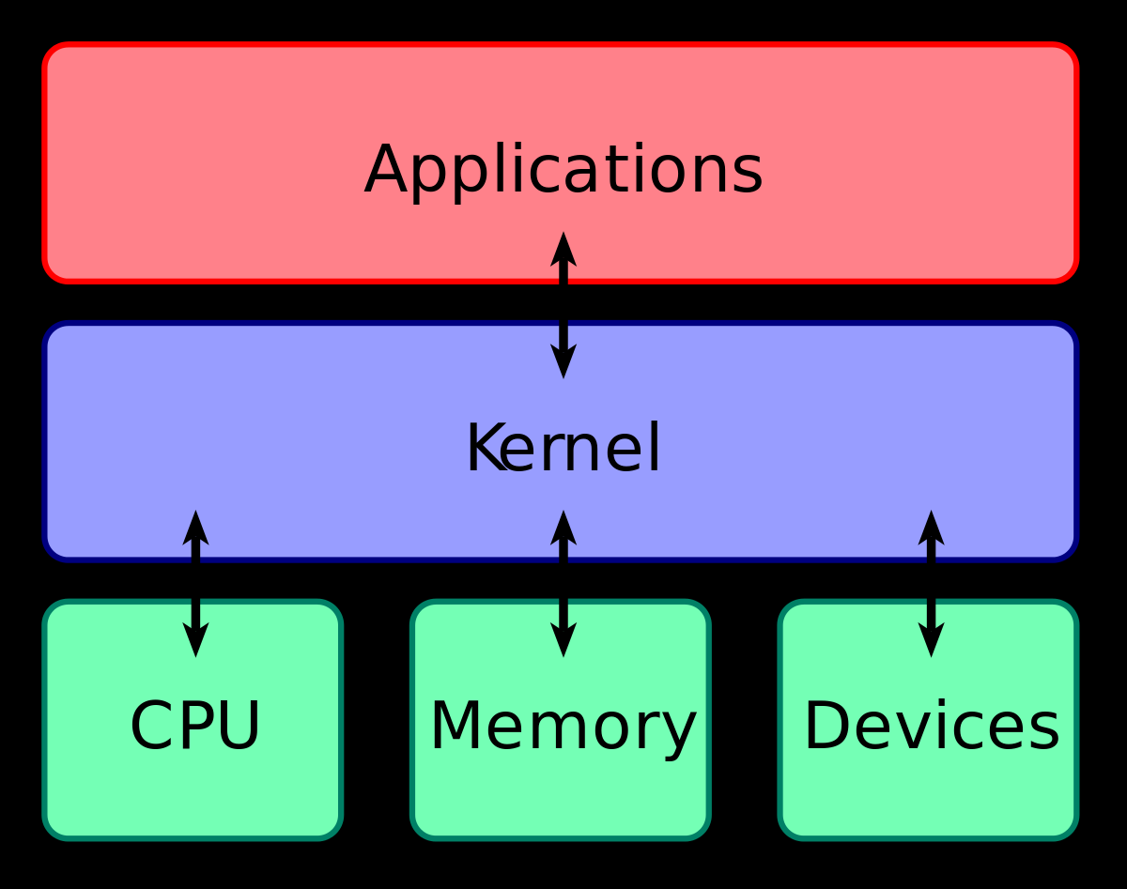
The Nuts and Bolts of Linux.
At its core level linux is a kernel that interacts with your computer’s hardware.
A kernel is the programming of the core operating system.
Outside the kernel are the shells.
The shell is the user interface that communicates with the kernel.

Slide 13
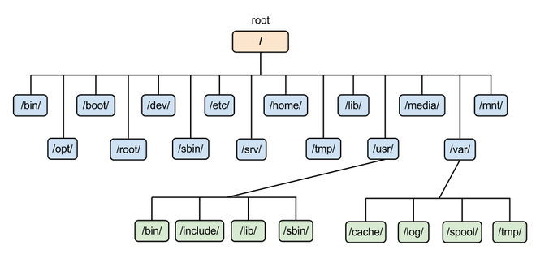
Linux’s Hierarchy
The file systems in linux are broken up into a bunch of directories.
Directories are the equivalent of folders.
For example, /home is a directory in the Linux file system.

Slide 14
Linux’s Hierarchy pt. 2
/ - filesystem root
/bin - contains programs
/sbin - contains programs for admins
/etc - configuration files for programs
/opt - downloaded programs
/home - each user has files live there
/dev - attached devices information (usbs)
/var - variable files(LOGS!)
/tmp - temporary files
. - current directory
.. - go up one directory
- - go back

Slide 15
Moving Around Linux
Since Linux is in command-line format, we use commands to navigate our file system.
pwd - Print working directory, shows where you currently are in the system i.e the working directory
cd <directoryname> - Change directory you are in
cd /home : Moves you to the “home” directory
ls - list all the files in the current folder
-a : list all files (including hidden)
Cat <filename> - Used for printing contents of file
File <filename> - Will tell you what the file type is.

Slide 16
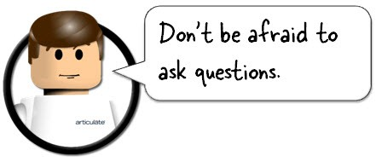
Start em up!
Log into machine
Password - bb123#123
The objective is to navigate to the calendar directory, which is in the etc directory.
Open terminal
Use the pwd command to see your working directory.
Then, use the cd command to navigate to the /etc directory.
Use pwd to print out file path.
Then cd into the /calendar directory
Use pwd again to print out the full file path.
Once in the calendar directory, use ls to display the contents of the directory.
Then, use file to see what type of file default is.
Use cat to print out contents of file default.

Slide 17
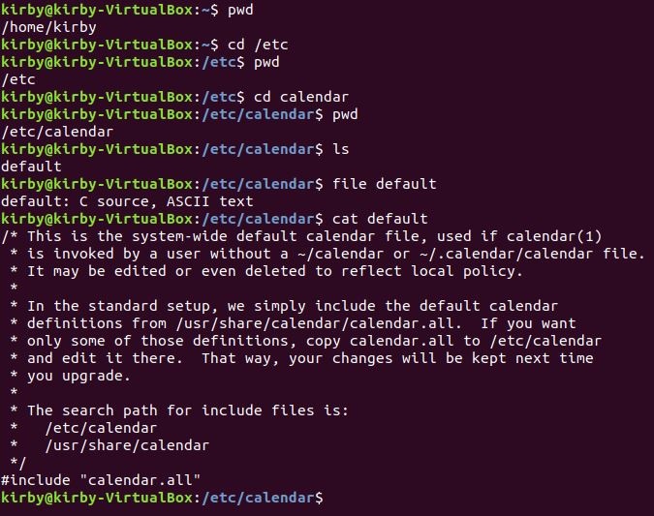
This is what you should see…

Slide 18
Manipulating your System.
touch <filename> - This command is used to create a file in whatever directory you are in.
rm <filename>- This command is used to remove or delete a file
mkdir <directoryname> - Used to create a directory
rmdir <directoryname>- Used to remove the specified directory.
nano <filename>- This is a text editor. Text editors are used to edit the contents of a file.
vi <file- Another text editor. (The inferior one).

Slide 19
Give it a Try!
Now that we have gone over how to directly create things in your system, let’s test it out.
Go back to your home directory by just typing cd.
First create a directory with the mkdir command. You can name it whatever you want.
Use ls to see if it worked
Next, cd into that directory.
Then create a file using the touch command. Again, name it anything.
Edit the file using nano. Type “Linux is cool.” in the file.
Use the commands listed on the bottom of nano to save and exit. (Ctrl + X >
Lastly, burn it all down. Delete the file with the rm command, then delete the directory with the rmdir command.
You can’t delete a directory from within, so make sure you cd somewhere else first.

Slide 20
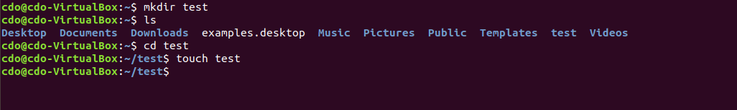
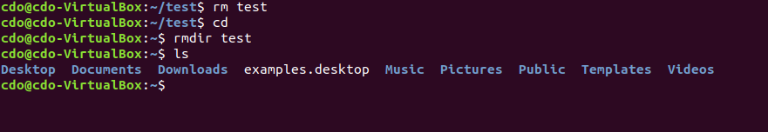
It should look like this...

Slide 21

Users and Groups
Linux also has users and groups to help manage its system.
Users are given an identification number called a UID.
Groups are given an identification number called a GID.
id <user or group> - command used to show the id of a specified user or group.

Slide 22

Commands for User/Group Management.
As we know, commands are used to do things in linux. So, these commands are used to manage users and groups.
useradd <username> - add new user
deluser <username>- delete user
groupadd <groupname>- create new group
groupdel <groupname>- delete group
usermod -aG <groupname> <username> - Add user to group.
whoami - show logged in
who - who else is logged in

Slide 23

Your turn!
usermod -aG
Let's give it a try.
Create a user with the useradd command. Call them “bob”.
Then, create a group with groupadd. Call the group “bob_group”
Next, add bob to bob_group with the usermod -aG command.
To check if it worked type “id bob”.
Now let's break it with groupdel and userdel.
Ask questions if you’re having problems.

Slide 24
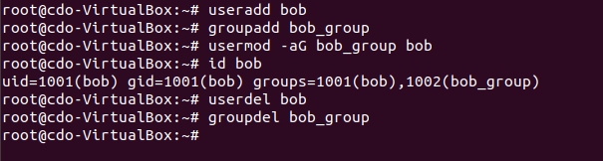
Take a look...

Slide 25
Questions so far?

Slide 26
How to manage everything?
<ctrl-c> : kill current process
<ctrl-z>: put current process in background
<tab>: complete the command
!!: re-run recent command
jobs : view background processes
history - view recent commands
clear or <ctrl-L) - clear the screen

Slide 27
Wondering what a Command Does?
The manual pages are built in to your Linux operating system to help you find out the usage of commands.
man - User manual for Linux distributions
man {option}
man find
If you keep getting an error on the command you are typing, always check the manual to see if you are doing it correctly!

Slide 28
Services
Linux can run a bunch of services. Each do their own thing and have different purposes.
Examples:
Mail Servers: Postfix,Dovecot
Web Servers: Apache/Apache2, nginx
Databases: MYSQL, MariaDB
And more!

Slide 29
Linux Resources
Over the wire - Practice Linux Navigation through SSH.
http://overthewire.org/wargames/
Linux Academy - Practice for CTF, Certifications, Hands-on Labs
https://linuxacademy.com/

Slide 30
Next time with Linux...
Something Cool :)

Slide 31
Announcements
Working on an interesting project? Have a specialty? Present
If you are interested in a topic/want to present email us! Cyberdefenseorg@albany.edu
OTHER STUFF?

Slide 32
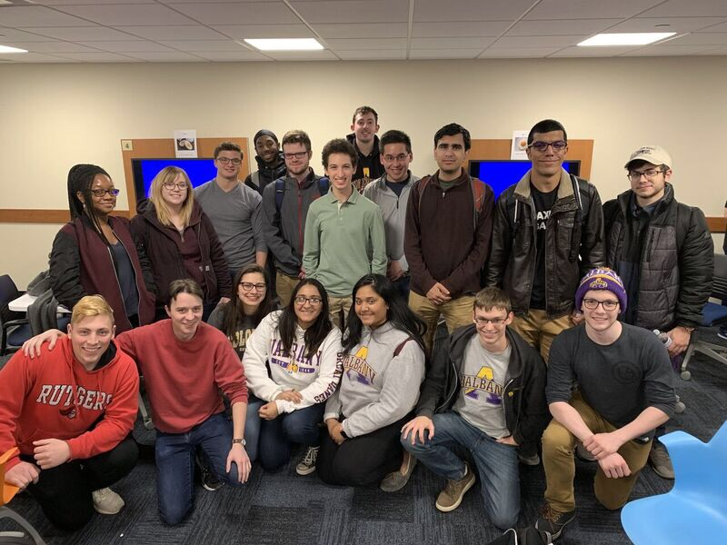
Join a Competition Team!
Monday nights at 7:15 in bb123.
Open training for competitions. Find out what specialty you’re interested in.
Linux, Windows, Firewall. They’re all super fun and interesting!
Multiple competitions! Cny, UBNet Def, CCDC, RIT Sec.

Slide 33

Certification Study Group - Security +
Tuesday nights at 7:15 in bb123.
Study as a group
Talk to Mark

Slide 34
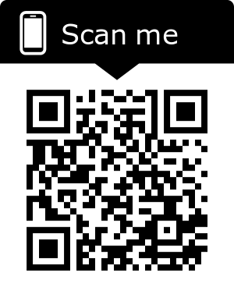
J-Board Applications!
OPEN POSITIONS:
Treasurer
IT-Chief Technology Officer
Competition Captain
Competition Co-Captain
EVERYONE SHOULD APPLY (:

Slide 35
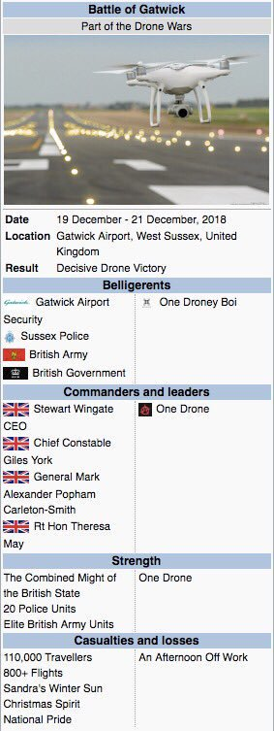
Other Updates!
CEHC Drone Lab Launch; Wednesday, February 27
Page Hall, basement Downtown Campus, University at Albany
3 pm Pre-fly event, student demos
4:15 Open house
4:45 Official ribbon cutting

Slide 36

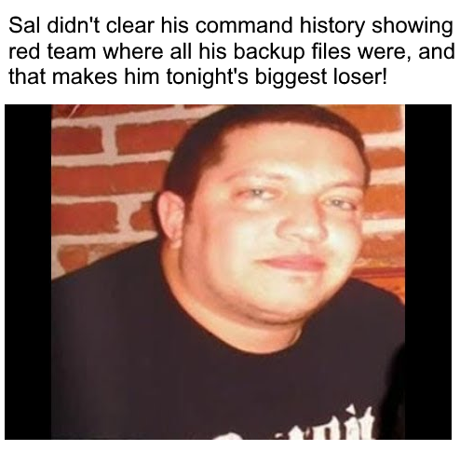
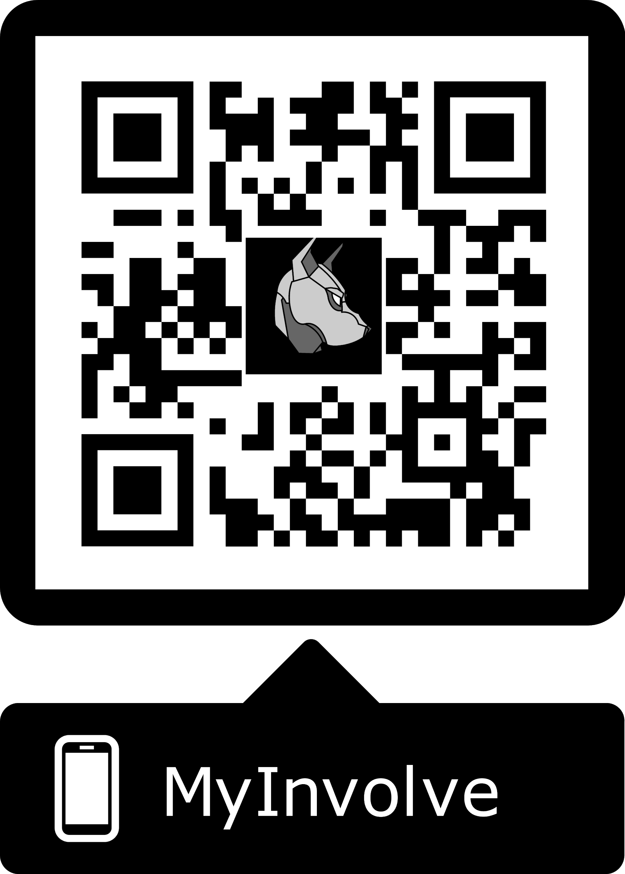
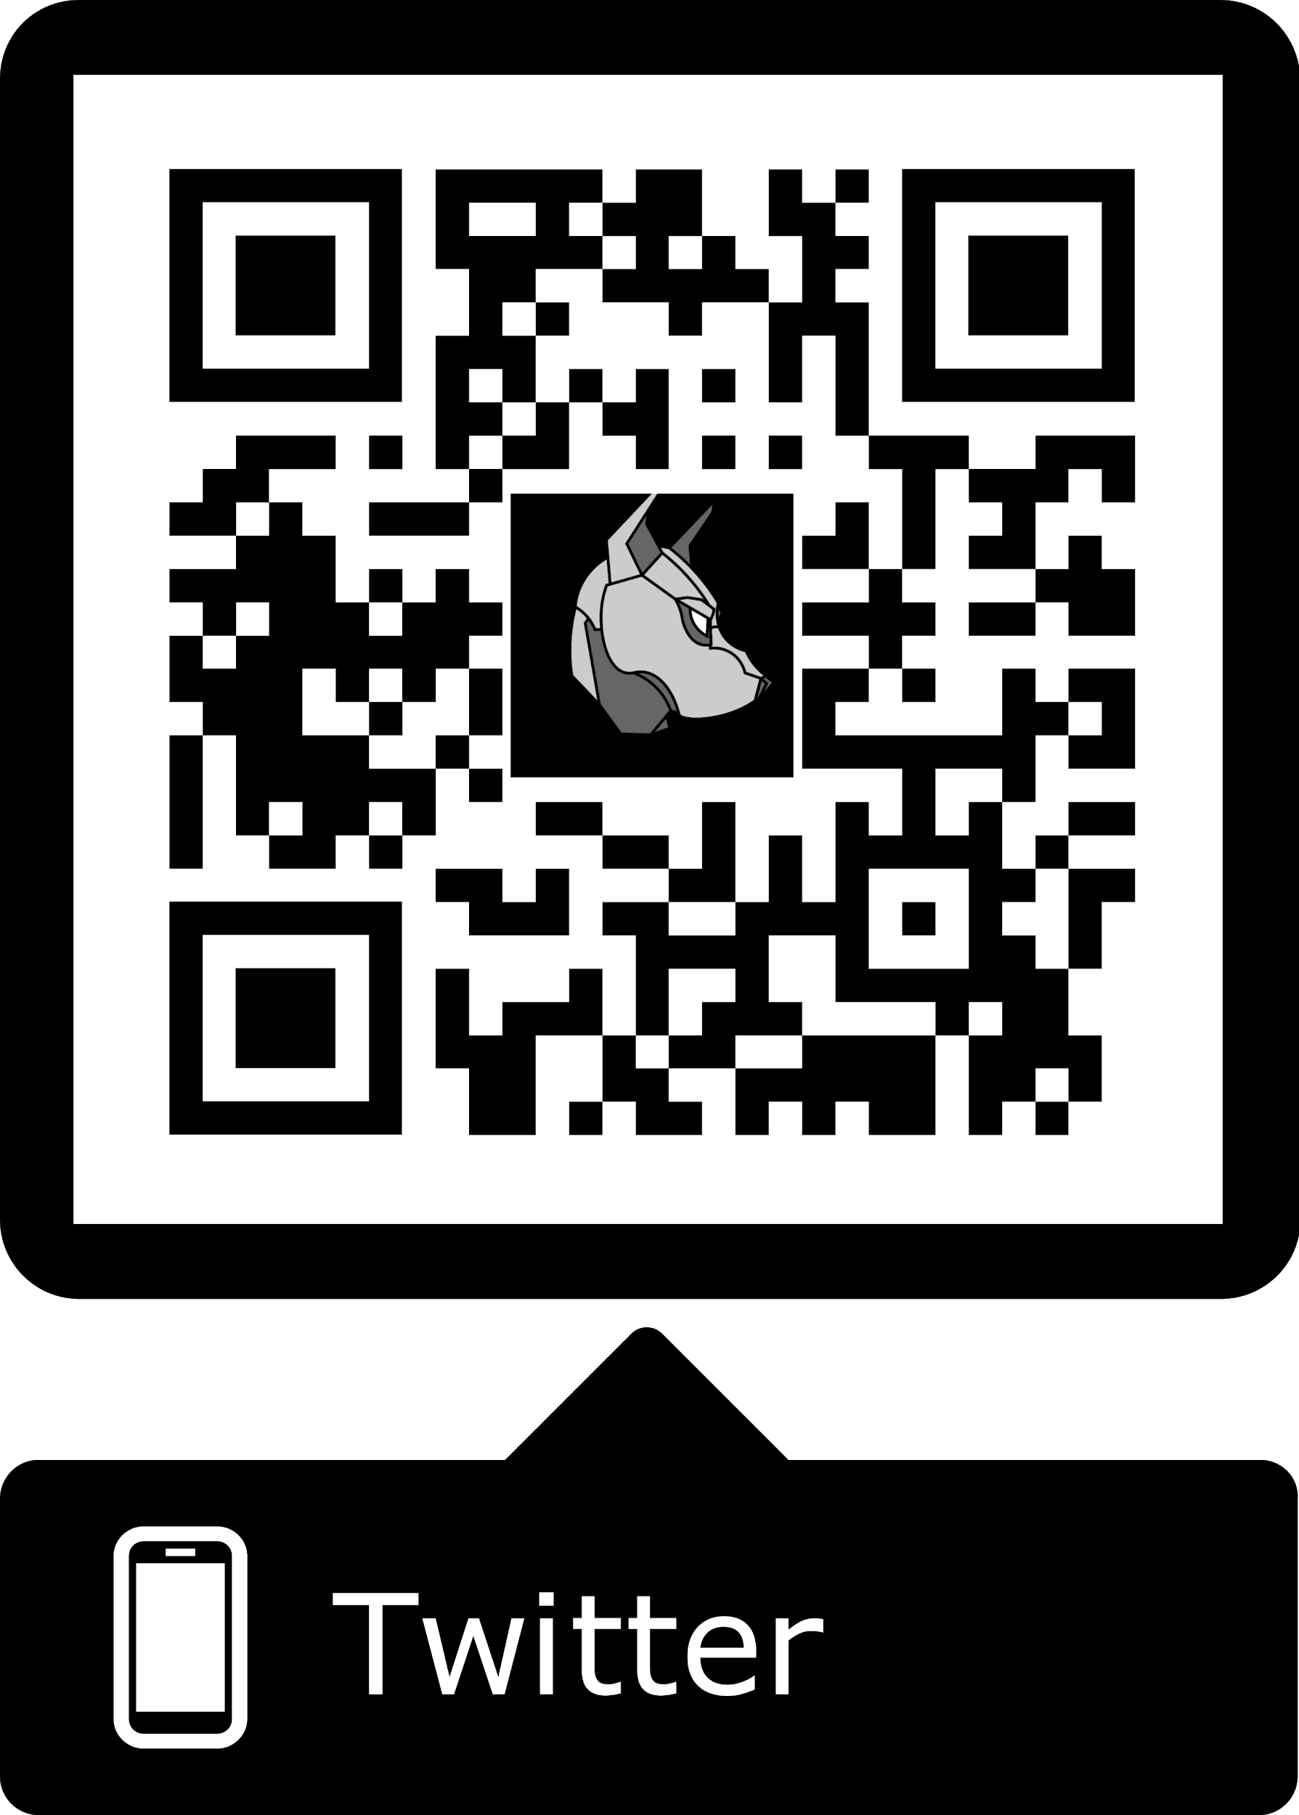
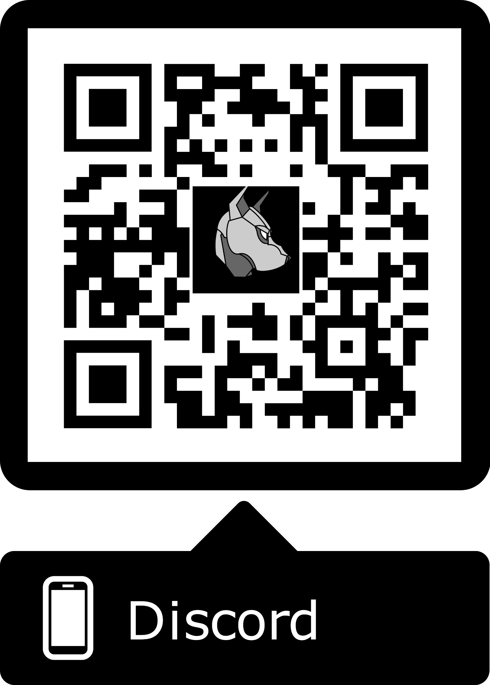
Cya Next week!
PC Assembly Workshop- February 19th(?)
If you have any good memes send them to the email below.
wcsmith@albany.edu
Follow us on Twitter? Add on myInvolvement?
CCDC! - Monday 7:30
BB123 (Check email).
https://discord.gg/9Dh6R5R

